Slide 1
Hospitality Service Performance Analysis and Optimization
Presented by:-
Sandy Alaa Ayad
Abanoub Wageeh Labeeb
Elia Onsy Wassef
Yusuf Ahmed Hassan Lotfy
Mohammed Ibrahim Mohammed
Mahmoud Anwar AbdulLateef

Slide 2
Data Warehouse Design
Task:-
Database Design: Design a SQL database schema for managing hotel booking and property operations data.
Tools:- SQL Server Management System (SSMS)
Steps:-
1 .Understand the requirements:
Identify entities and define relationships between entities.
2 .Create fact tables:
Build fact tables like fact_booking and fact_properties_operation to store transaction-related
information.
3 .Create dimension tables:
Build fact tables like dim_date, dim_hotels and dim_rooms.
4 .Establish relationships:
Define foreign key relationships between fact and dimension tables.
5 .SQL Implementation:
Write SQL code to create the schema with the appropriate constraints (primary and foreign keys).

Slide 3
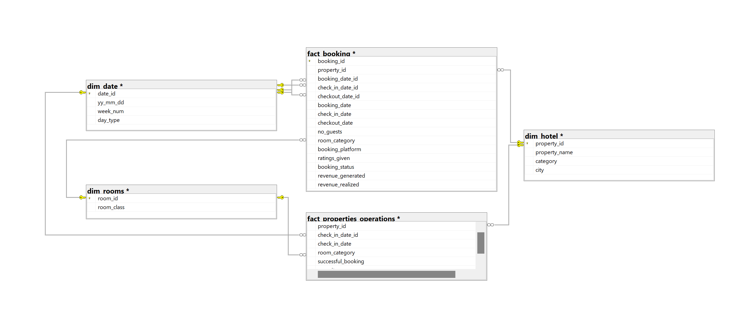
Data Warehouse Design
The Design

Slide 4
ETL Process
Using SSIS and python script we were able to :
Extract: Data was extracted from [3 Excel files – 2 CSV files].
Transform:
Datatype Conversion: Ensured data types matched the data warehouse schema.
Derived Columns: Created new columns based on existing data for better analysis.
Load: Loaded the transformed data into [data warehouse: DW_Hospitality_Analysis].

Slide 5
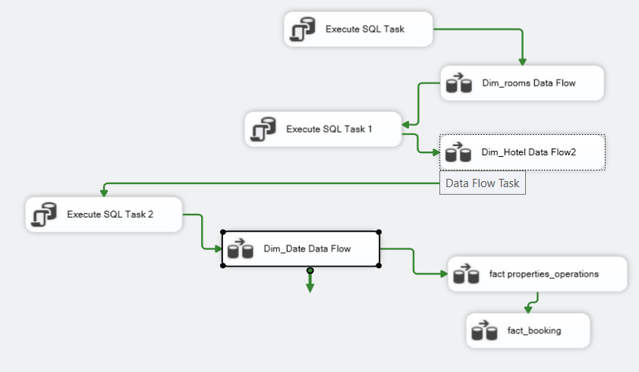
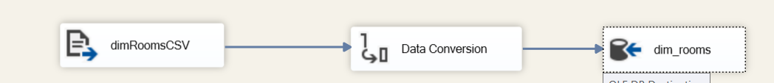
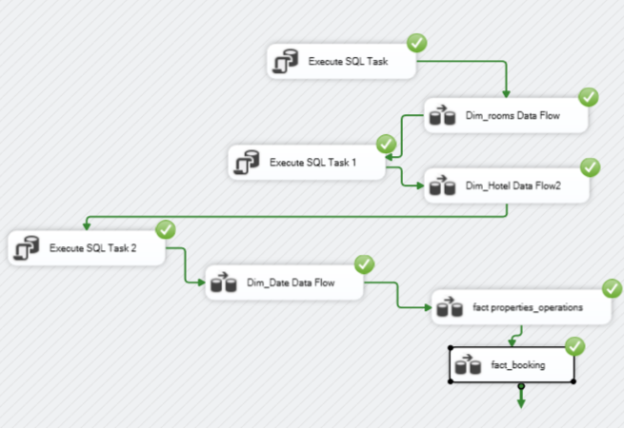
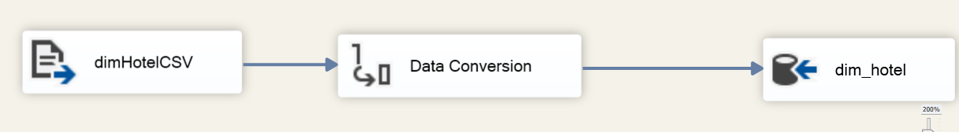
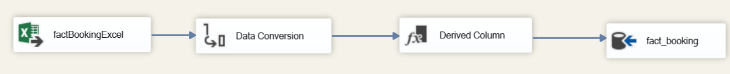
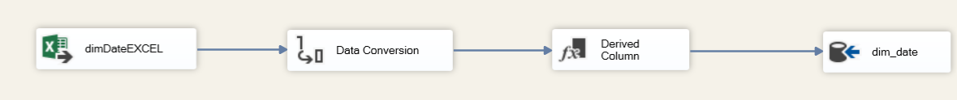
1-ETL process using SSIS
Using 5 data flow tasks in SSIS

Slide 6
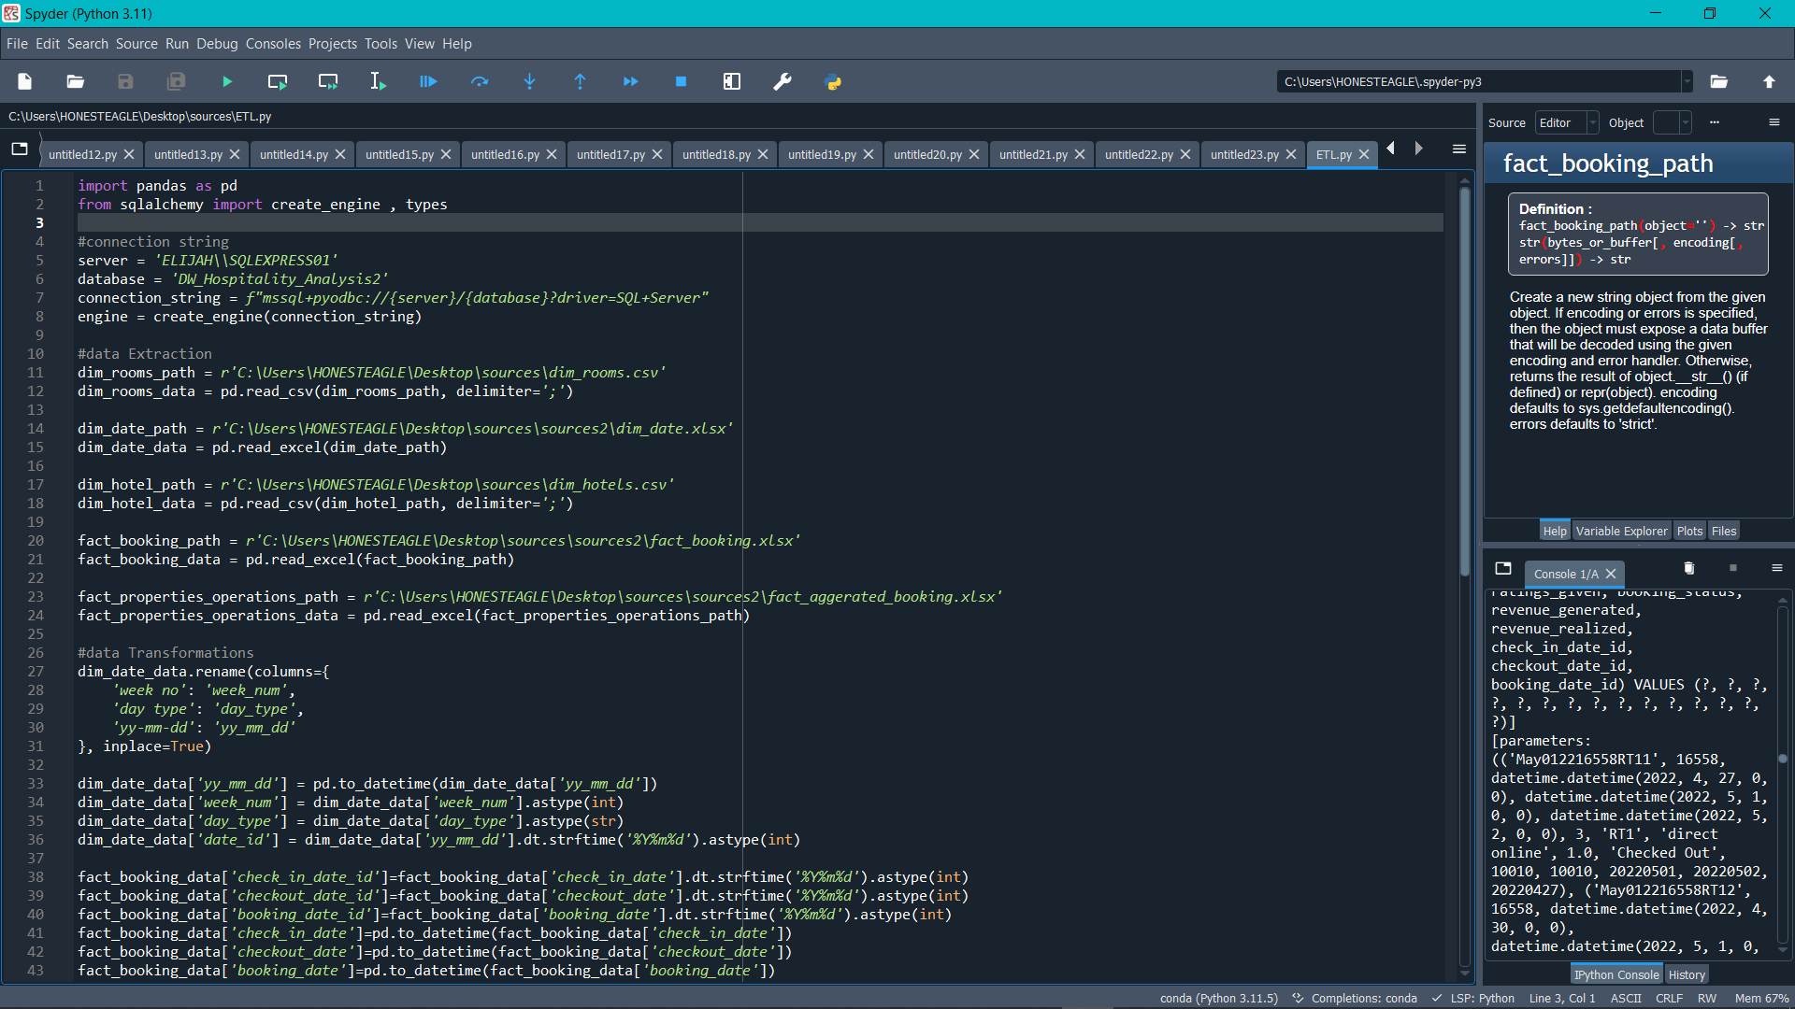
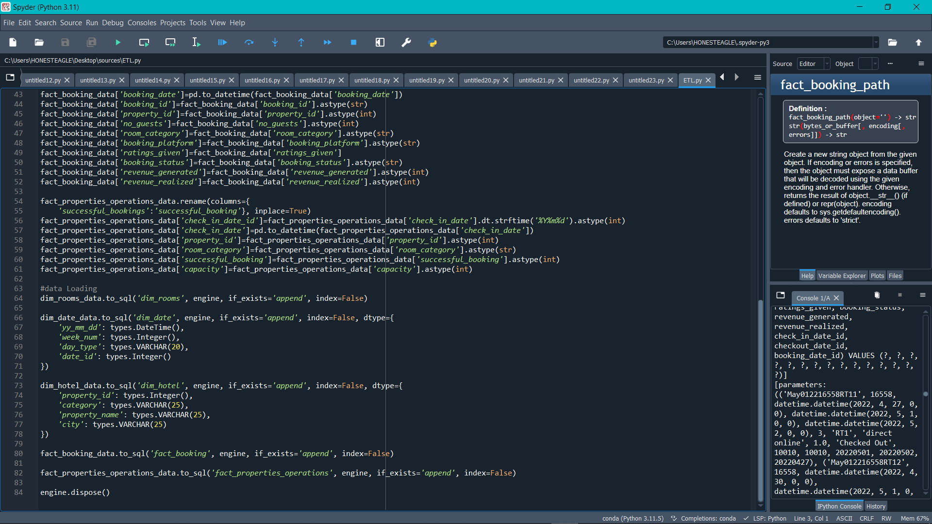
2- ETL Process Using Python
Using Python script in ETL process using pandas and SQLAlchemy

Slide 7

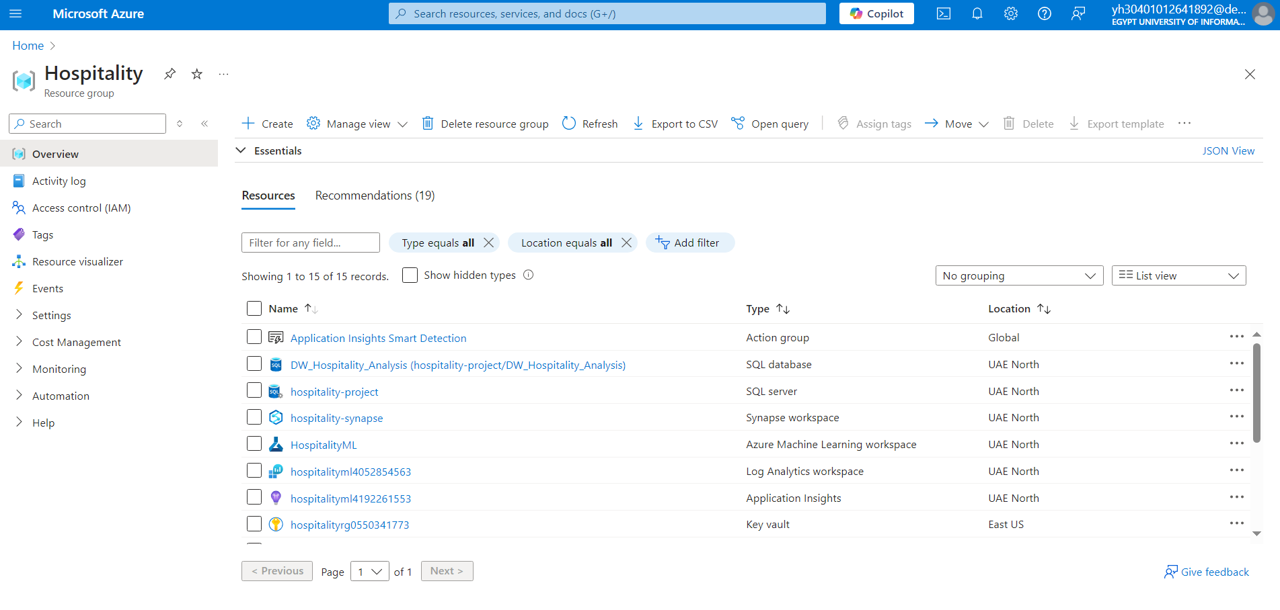
MICROSOFT AZURE
Storing Data into an Azure SQL Database hosted on an Azure SQL Server:
Creating a new resource group that will include instances of resources and workspaces:

Slide 8

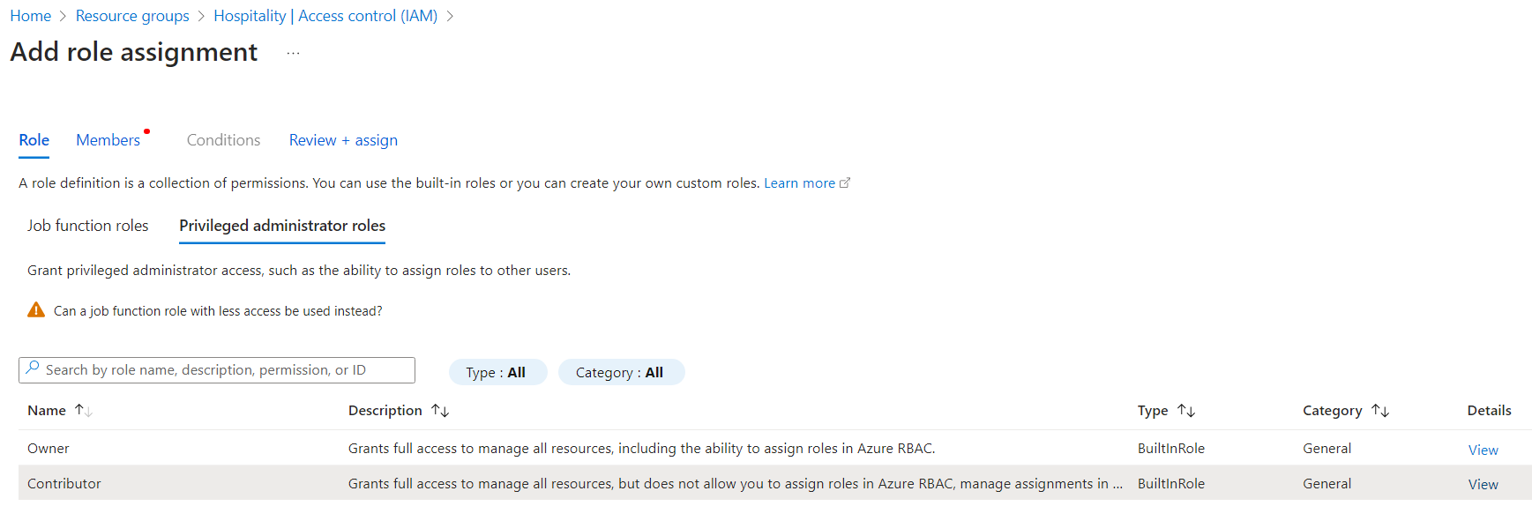
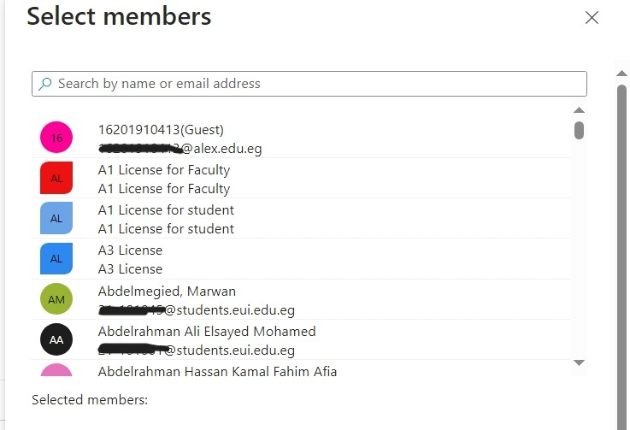
Giving Access to the resource group to coworkers:

Slide 9
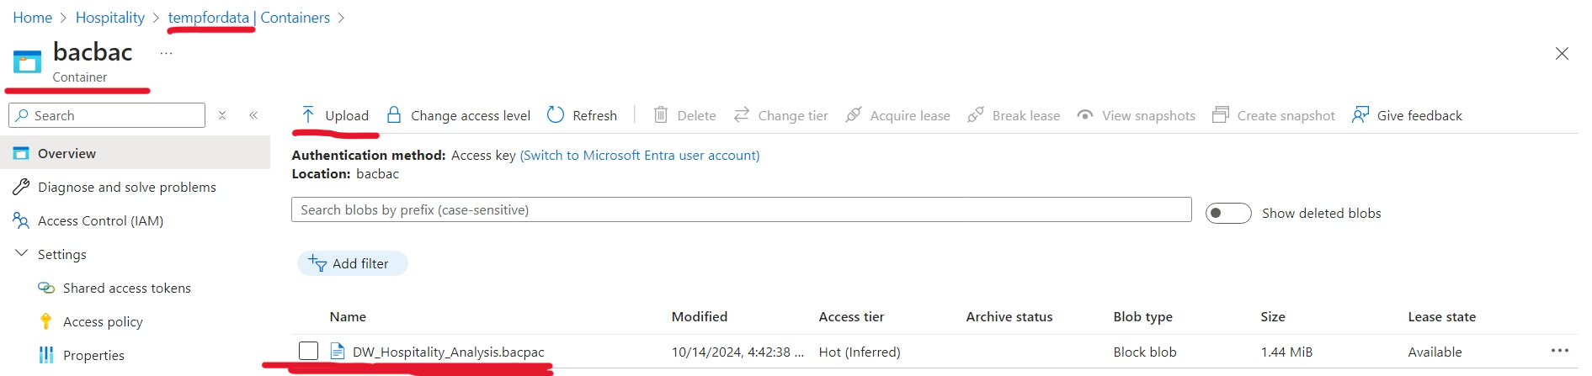
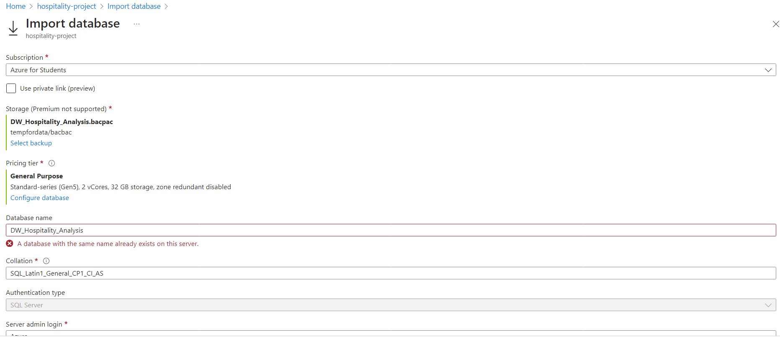
Creating Azure SQL Server instance and uploading the database
Upon creating the Azure SQL Server inside the resource group, we uploaded our local database as a .bacbac file into a temporary Azure storage account
Then we created and populate a database inside the Azure SQL Server :

Slide 10
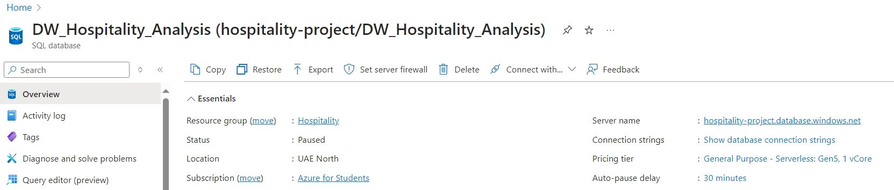
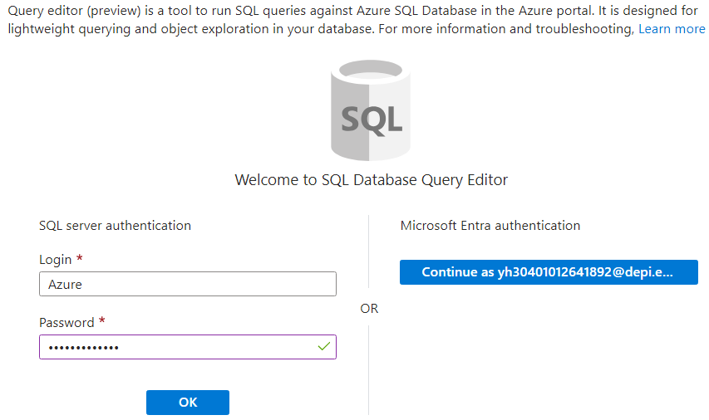
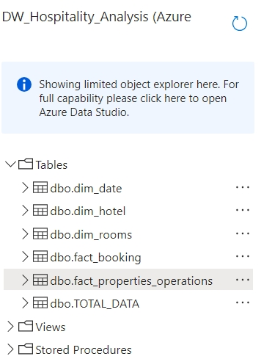
After the creation of the database we checked that it’s populated with all the tables

Slide 11

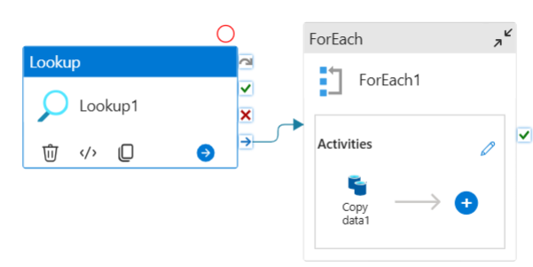
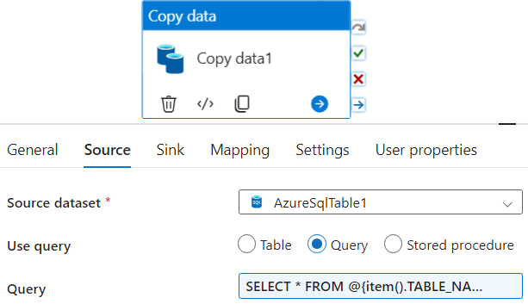
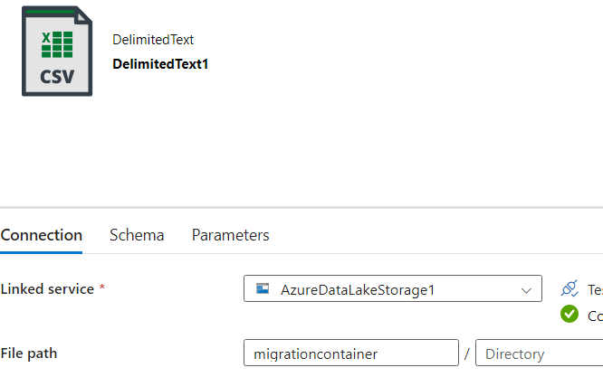
Transfering the data from the Azure SQL Database into a storage account as .csv files using Azure Data Factory
the look up activity Query:
SELECT TABLE_NAME
FROM INFORMATION_SCHEMA.TABLES
WHERE TABLE_TYPE = 'BASE TABLE';

Slide 12
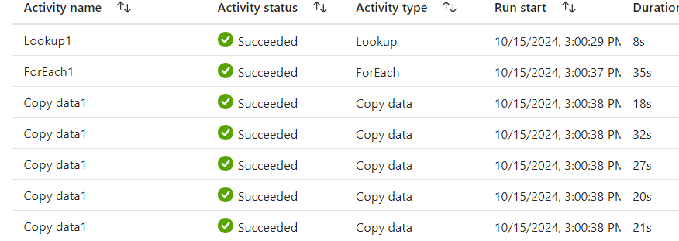
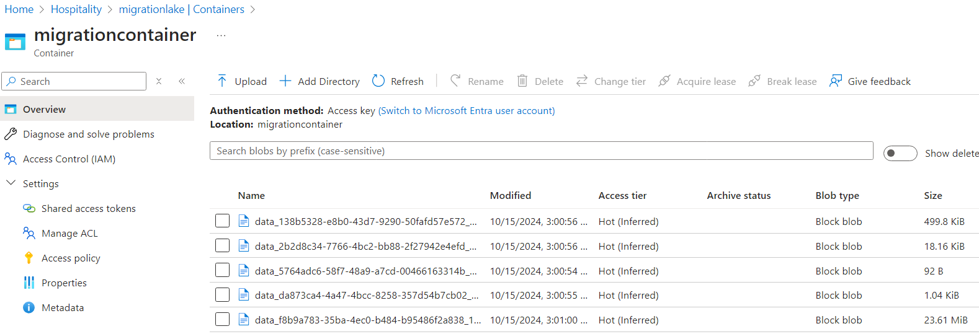
We triggered the pipeline and monitored it’s workflow and checked the storage account

Slide 13

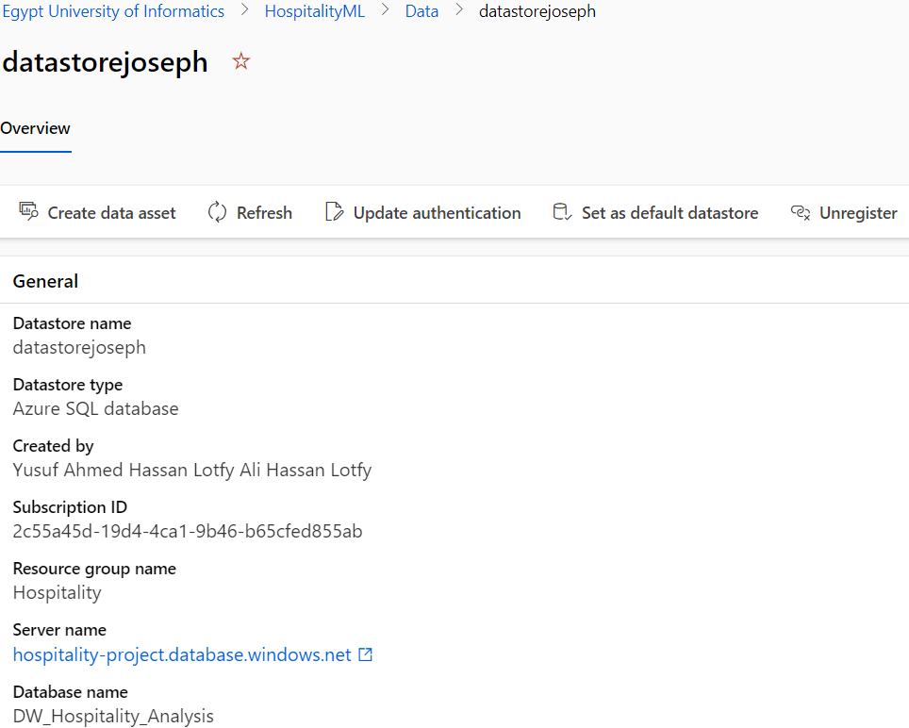
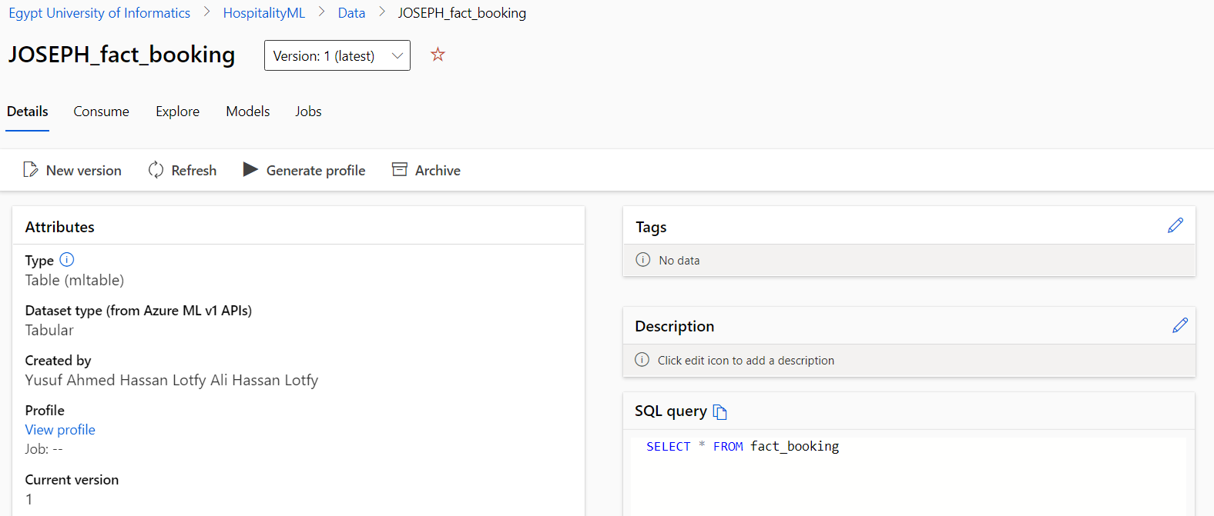
Integrating the database to be ready to use in Azure ML Studio

Slide 14
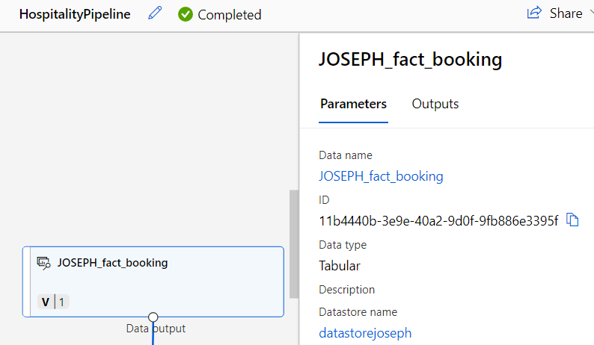
Now The needed data is ready to be used inside the Azure ML Studio

Slide 15
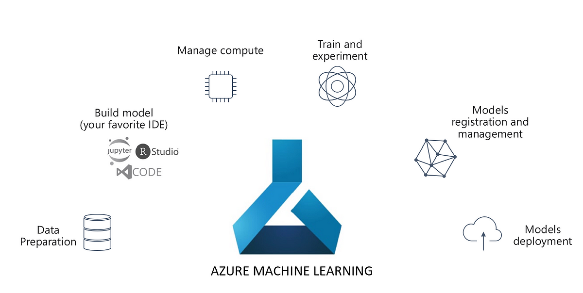
Azure ML
Azure Machine Learning (Azure ML) is a cloud-based service provided by Microsoft that enables developers and data scientists to build, train, and deploy machine learning models at scale

Slide 16

Agenda
Purpose of Model
Data Prepration
Select & Split
Choosing ML Model
Train & Score
Evaluate Model
Final Result

Slide 17
Purpose of Model
Identifying Potential Customers
In our model, we categorized customers into three distinct groups:
Booked and Canceled
Booked and Checked Out
Booked and Did Not Show
This classification allows us to identify our potential and loyal customers. By understanding these categories, we can tailor offers and promotions specifically for our most promising client. Additionally, this insight enables us to deliver more targeted advertisements, enhancing our ability to predict customer behavior and improve engagement.

Slide 18
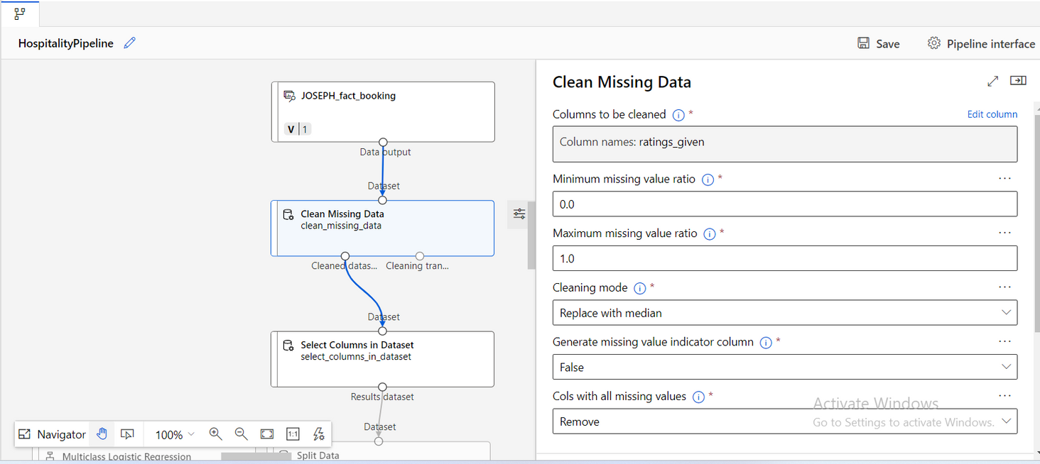
Data Prepration
"Data Cleansing: Filling the Gaps"
In this stage, I replaced null values in the “rating column” using the median, ensuring data quality and reliability for our analysis.

Slide 19
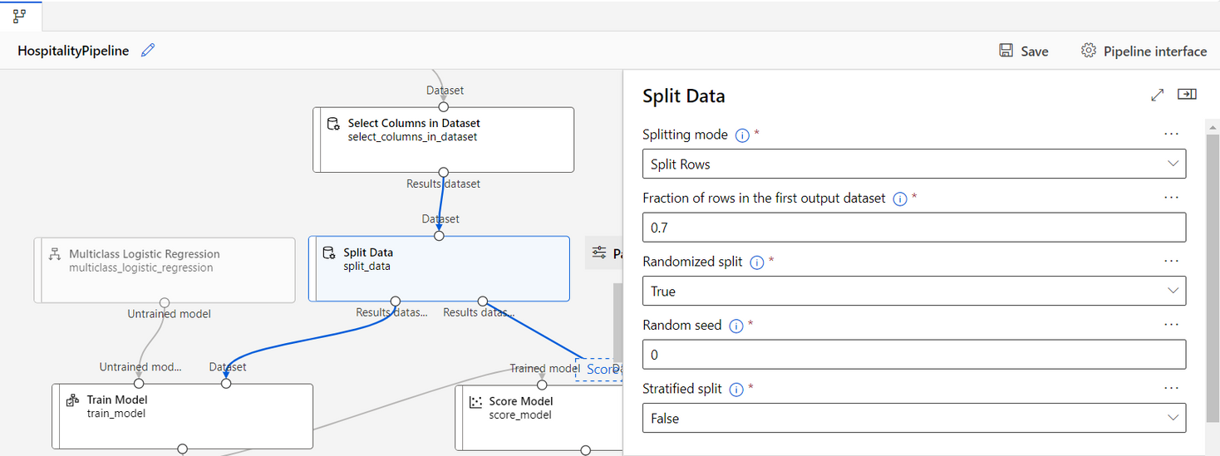
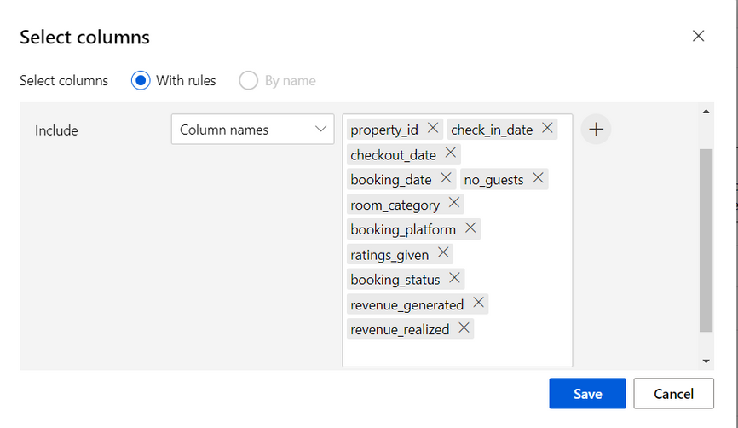
Select & Split
"Feature Selection: Defining Our Focus"
I selected key columns to build the model, including property_id, check_in_date, checkout_date, booking_date, no_guests, room_category, booking_platform, ratings_given, booking_status, revenue_generated, and revenue_realized. The data was then split and shuffled into a 70:30 ratio for training and testing.

Slide 20
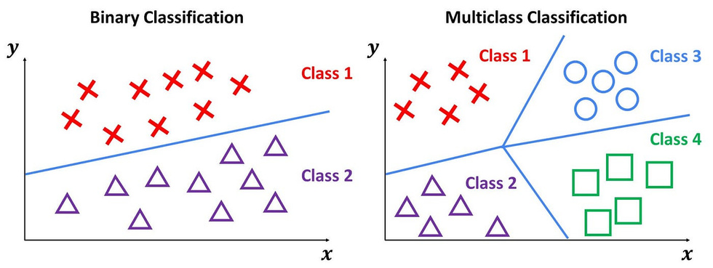
Choosing ML Model
"Choosing the Right Model: Multiclass Logistic Regression"
For classification, I utilized multiclass logistic regression to differentiate between the three outcomes: cancel, no-show, and check-out.
Multiclass Logistic Regression
Overview: Multiclass logistic regression is an extension of binary logistic regression, used for predicting categorical outcomes with more than two classes. It models the relationship between one or more predictor variables and a categorical response variable by estimating probabilities for each class.

Slide 21
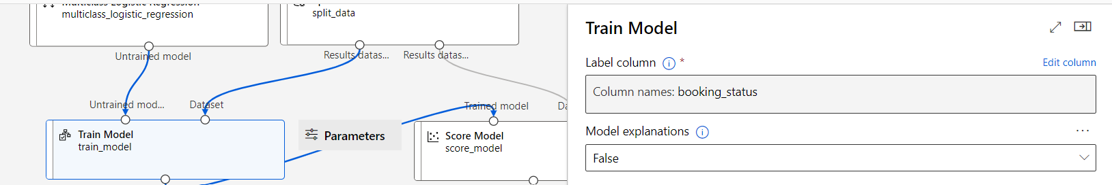
Train & Score
"Training the Model: Learning from Data"
During this stage, the model was trained on 70% of the dataset to find the optimal function for classification. The remaining 30% of the data was used to test the model's performance and validate its predictive capabilities.

Slide 22
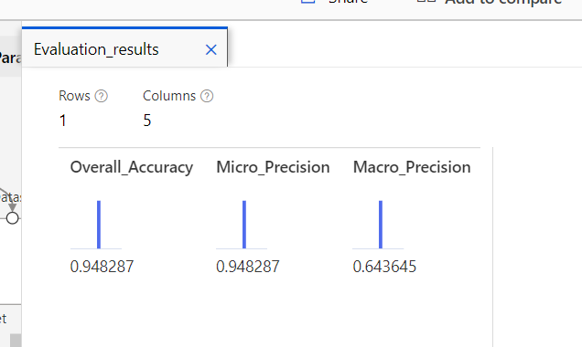
Evaluate Model
"Evaluating Success: Metrics that Matter"
I employed metrics such as accuracy and precision to assess how well our model performed, providing insight into its effectiveness in predicting user behavior.

Slide 23
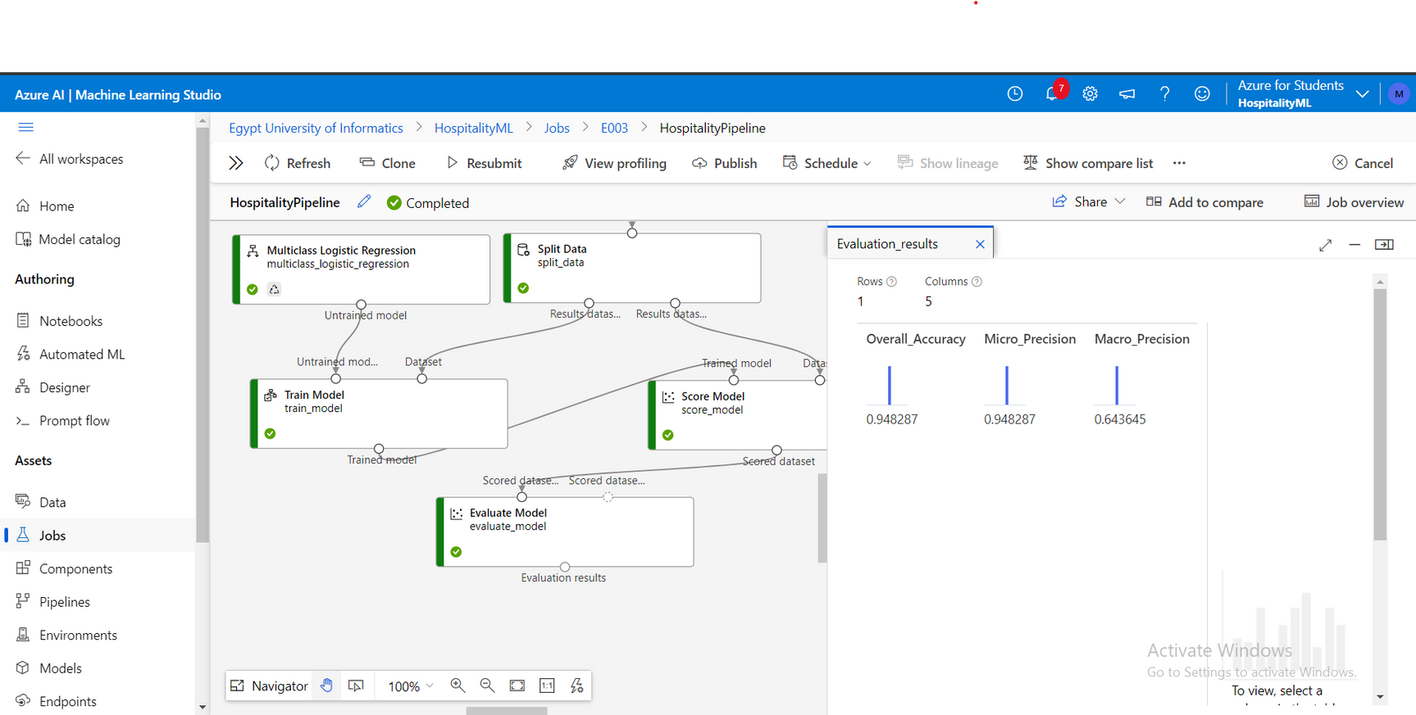
Final Result

Slide 24
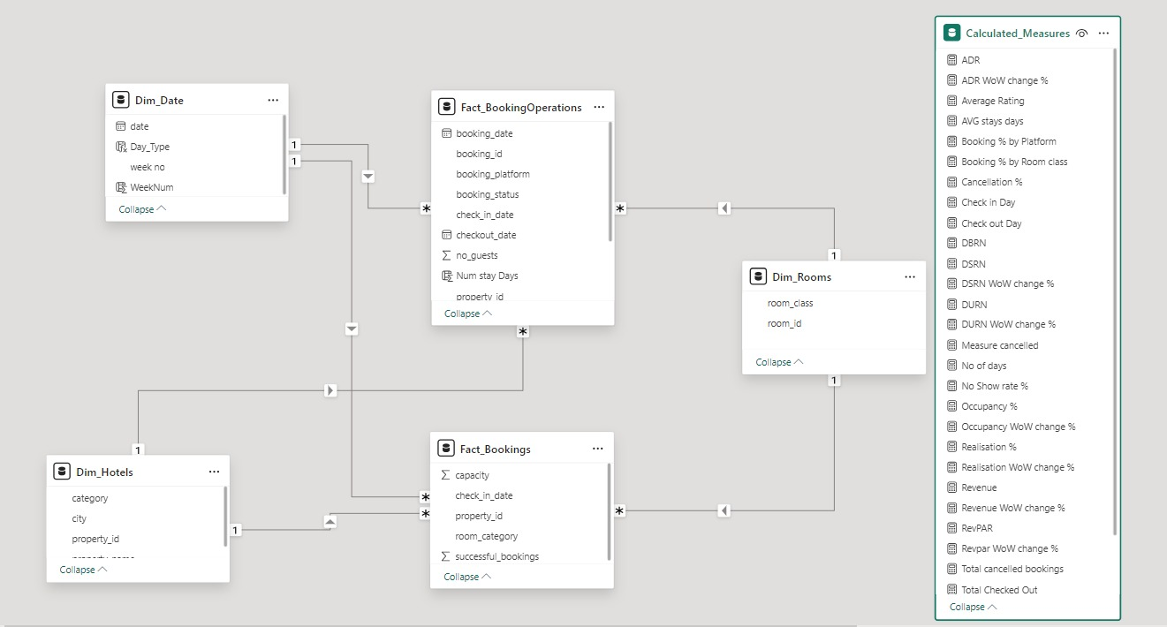
POWER BI

Slide 25
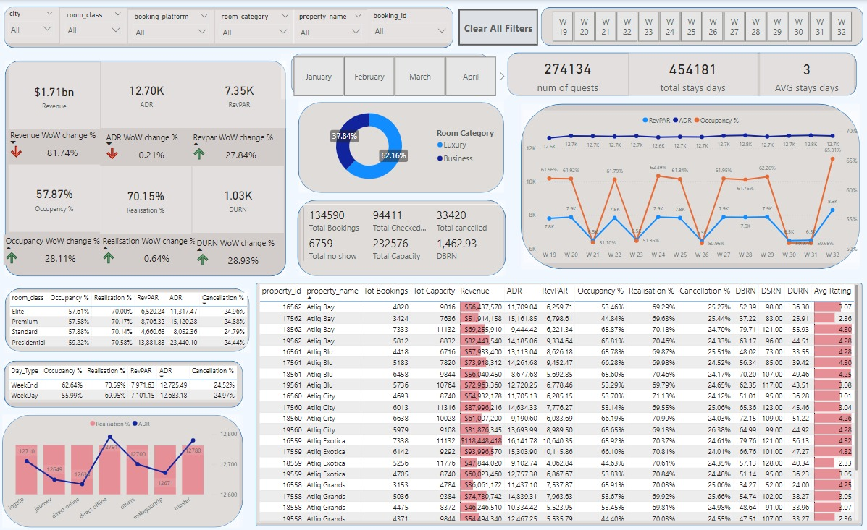
POWER BI

Slide 26

Any Questions ??

Slide 27






Our team:
Yusuf Ahmed Hassan Lotfy Ali
Student at HIET-Sohag
Mohammed Ibrahim Mohammed
Student at faculty of Engineering
Sohag University
Elia Onsy Wassef
Student at faculty of Engineering
Assiut University
Mahmoud Anwar Abd-El-Lateef
Graduate from faculty of commerce
Sohag University
Sandy Alaa Ayad
Student at faculty of Engineering
Sohag University
Abanoub Wageeh Labeeb
Student at faculty of Computer

Slide 28
THANK YOU

